Slide 1


Slide 2
FIND and FILE macros

Slide 3
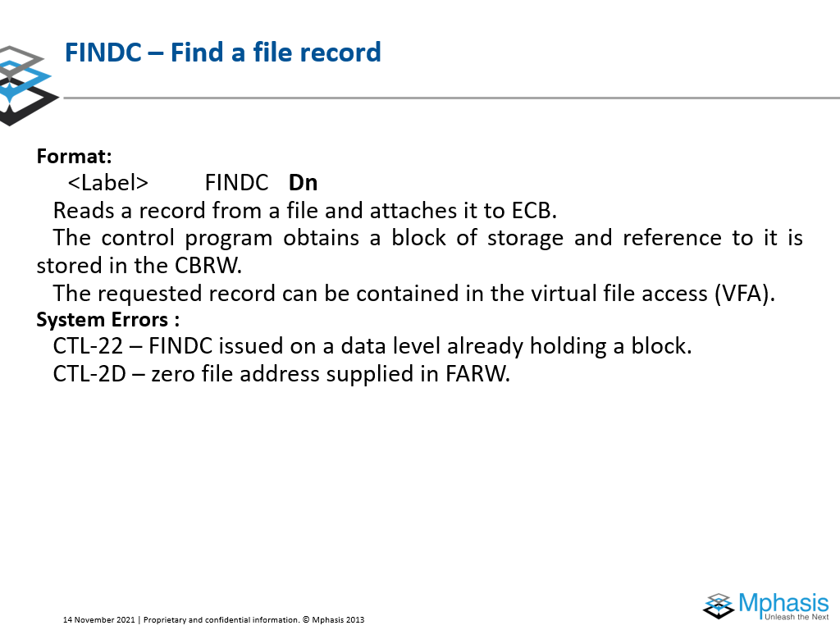
ADVANCED instructionS

Slide 4
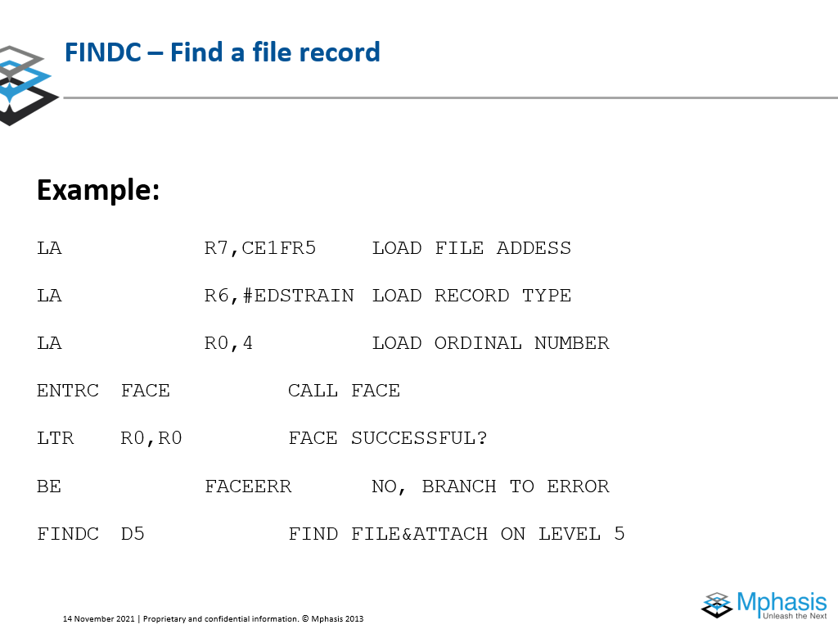
FINDC- Find a File Record
Replaces 8 bit quantities with other 8 bit quantities that are determined according to a translation table.
Each byte in the first operand is used as an 8 bit index into the translation table addressed by the second operand.
TR D1(L,B1),D2(B2)
Format – SS
Condition Code – Not Changed
Exceptions – Access - Fetch 2nd, Store 1st
DC | L | B1 | D1 | B2 | D2

Slide 5
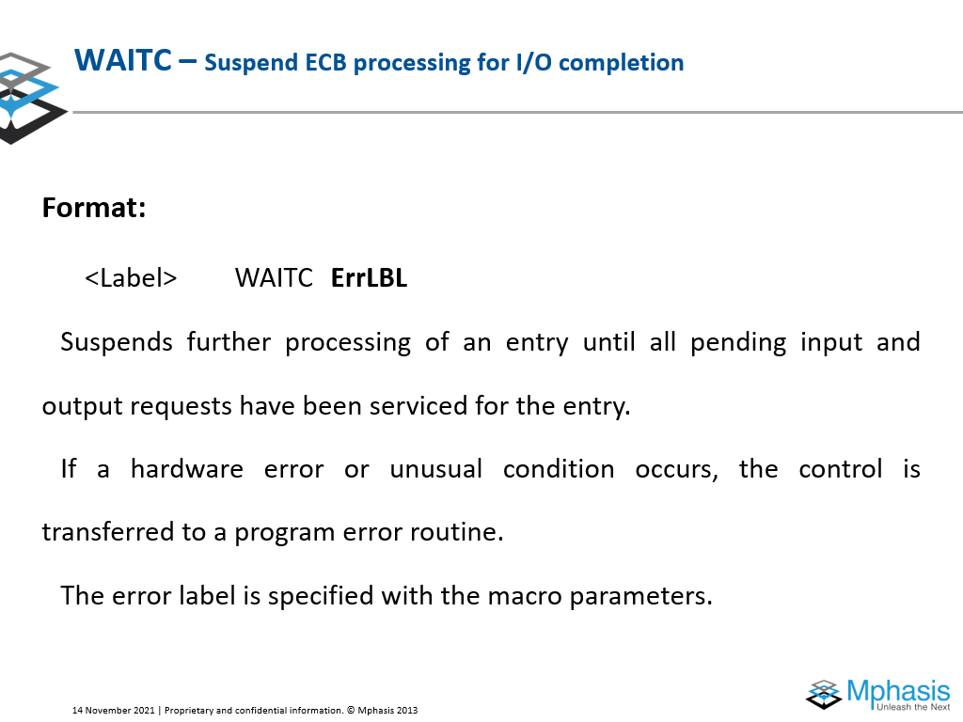
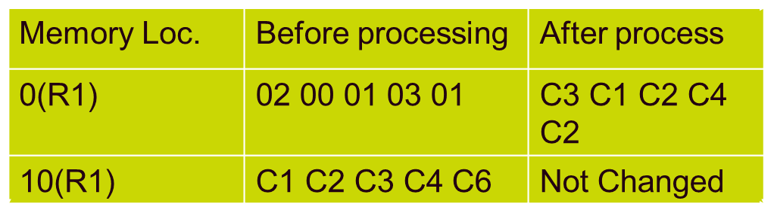
Translate
Eg., TR 0(5,R1),10(R1)
Op code – DC 04 10 00 10 0A

Slide 6
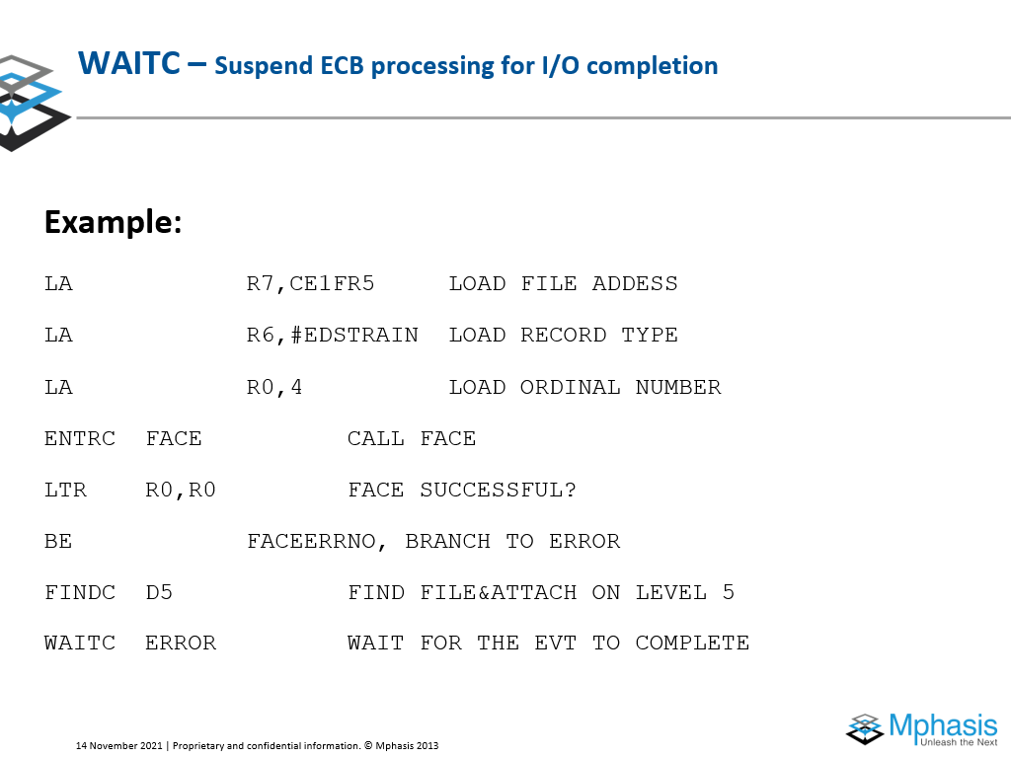
Move with Offset
First Operand is replaced by the second operand.
Rightmost 4 bits of the first operand remain unchanged.
If first operand is longer the instruction pads the result on the left with zeros, else if first operand is short, the result is truncated on the left without warning.
MVO D1(L1,B1),D2(L2,B2)
Format – SS
Condition Code – Not Changed
Exceptions – Access - Fetch 2nd, Store 1st
F1 | L1 | L2 | B1 | D1 | B2 | D2
Notes:
-9/-4 => 2,-1
9/4 => 2,1
9/-4 => -2,1
-9/4 => -2,-1

Slide 7
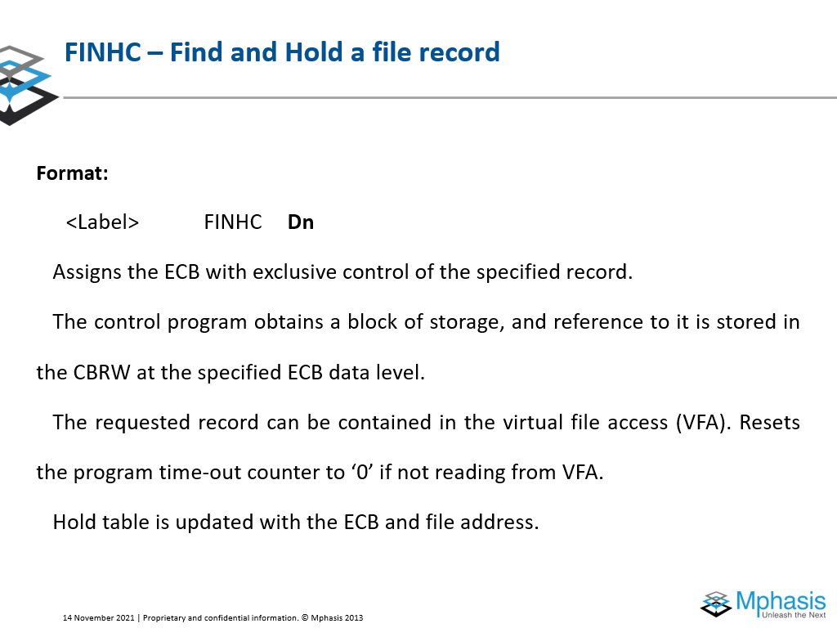
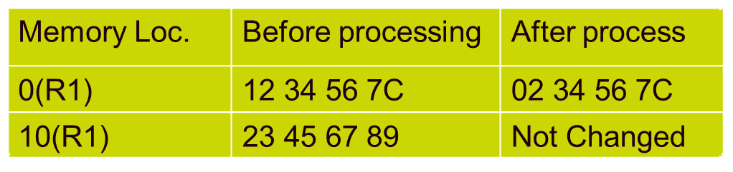
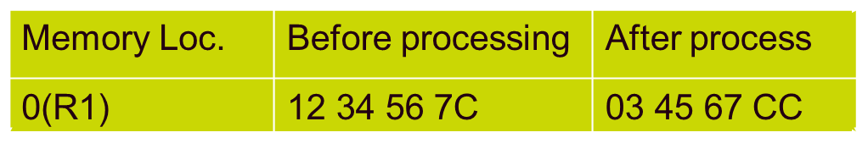
Move with Offset
Eg., MVO 0(4,R1),10(3,R1)
Op code – F1 32 10 00 10 0A
Eg., MVO 0(4,R1),1(3,R1)
Op code – F1 32 10 00 10 01
Notes:
-9/-4 => 2,-1
9/4 => 2,1
9/-4 => -2,1
-9/4 => -2,-1

Slide 8
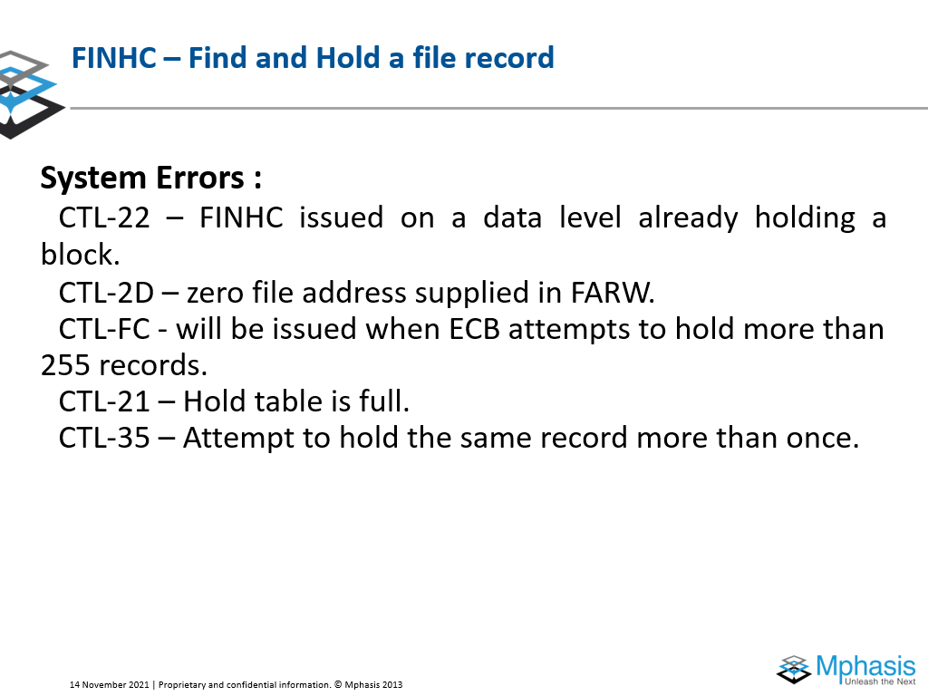
Move Numerics
First Operand is replaced by the second operand.
Only Rightmost 4 bits of every byte of the first operand is replaced by the rightmost 4 bits of every byte of the second operand.
MVN D1(L,B1),D2(B2)
Format – SS
Condition Code – Not Changed
Exceptions – Access - Fetch 2nd, Store 1st
D1 | L | B1 | D1 | B2 | D2

Slide 9
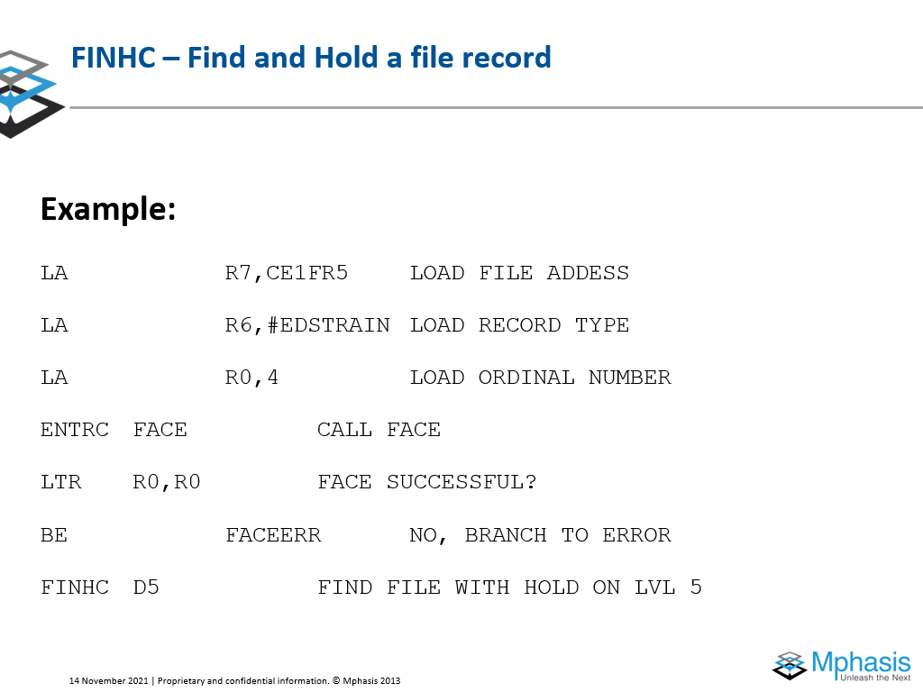
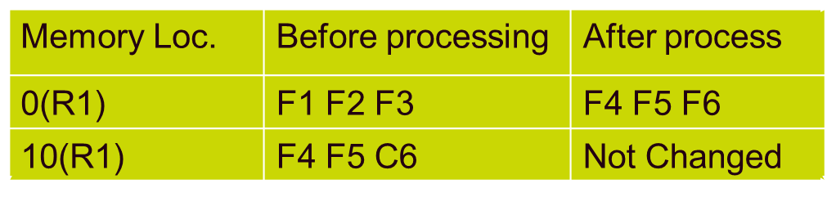
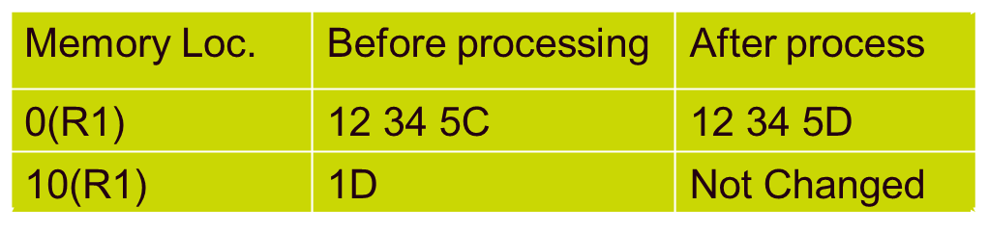
Move Numerics
Eg., MVN 0(3,R1),10(R1)
Op code – D1 02 10 00 10 0A
Eg., MVN 2(1,R1),10(R1)
Op code – D1 00 10 02 10 0A

Slide 10
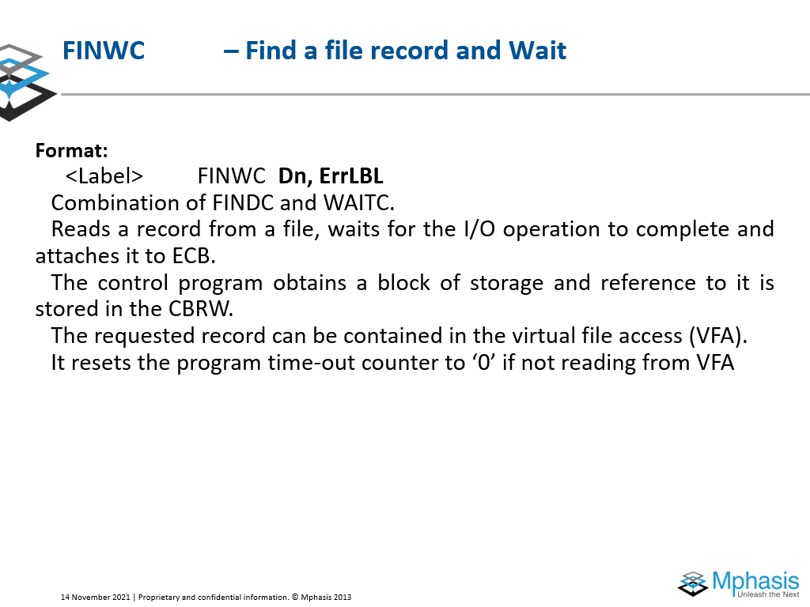
Move Zones
First Operand is replaced by the second operand.
Only Leftmost 4 bits of every byte of the first operand is replaced by the leftmost 4 bits of every byte of the second operand.
MVZ D1(L1,B1),D2(B2)
Format – SS
Condition Code – Not Changed
Exceptions – Access - Fetch 2nd, Store 1st
D3 | L | B1 | D1 | B2 | D2

Slide 11
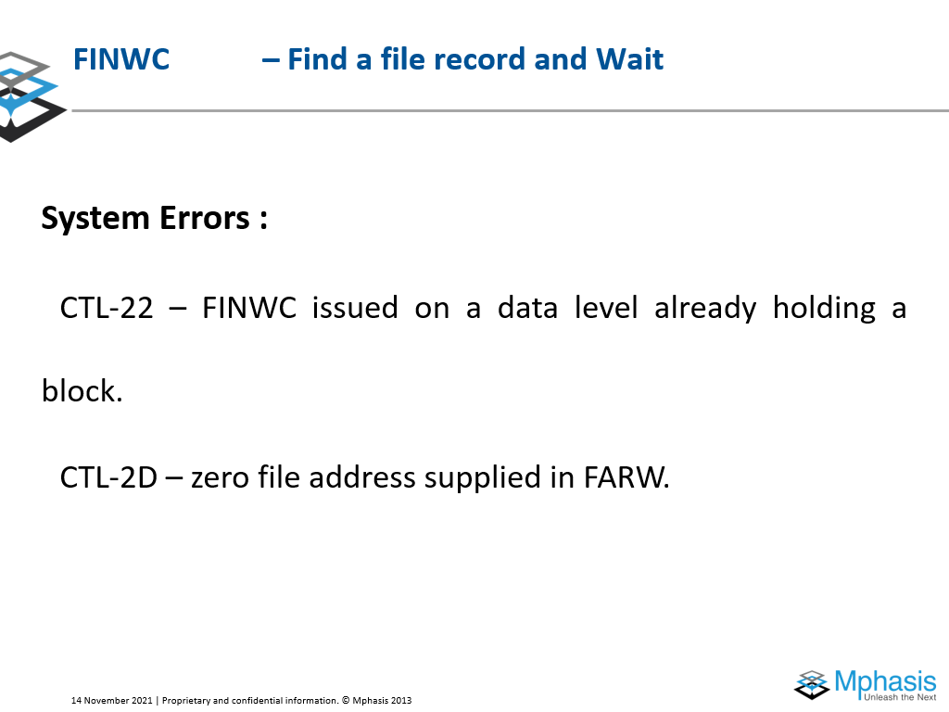
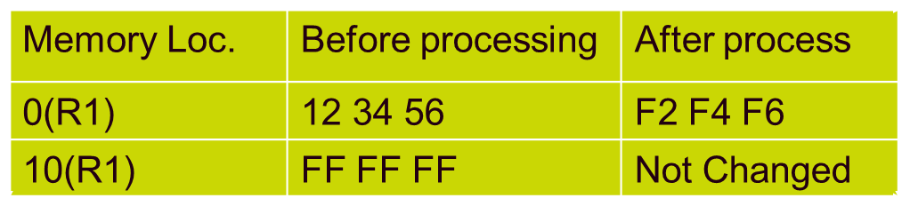
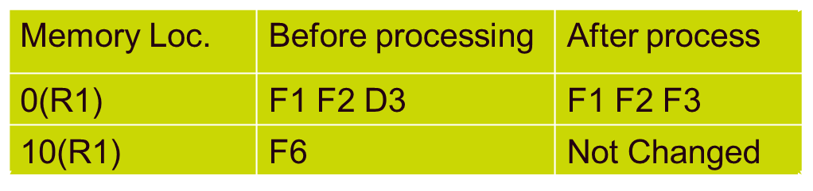
Move Zones
Eg., MVZ 0(3,R1),10(R1)
Op code – D3 02 10 00 10 0A
Eg., MVZ 2(1,R1),10(R1)
Op code – D3 00 10 02 10 0A

Slide 12
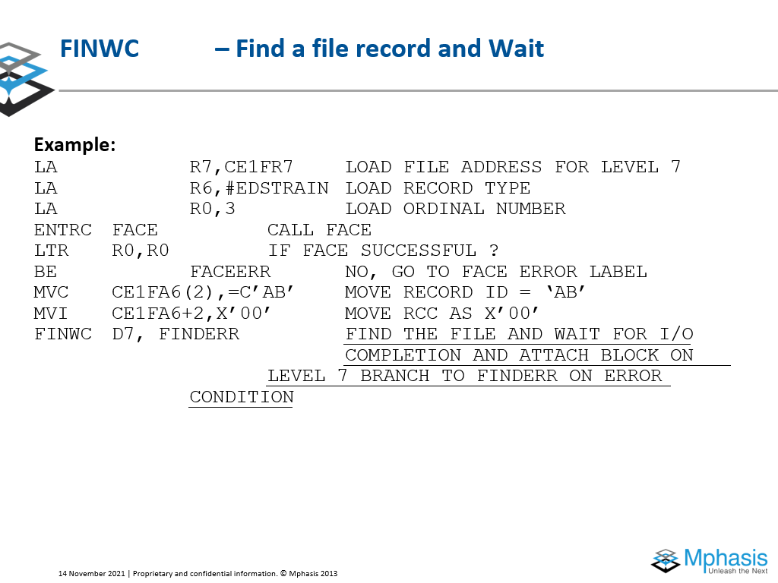
Move Zones
Eg., MVZ 0(3,R1),10(R1)
Op code – D3 02 10 00 10 0A
Eg., MVZ 2(1,R1),10(R1)
Op code – D3 00 10 02 10 0A

Slide 13
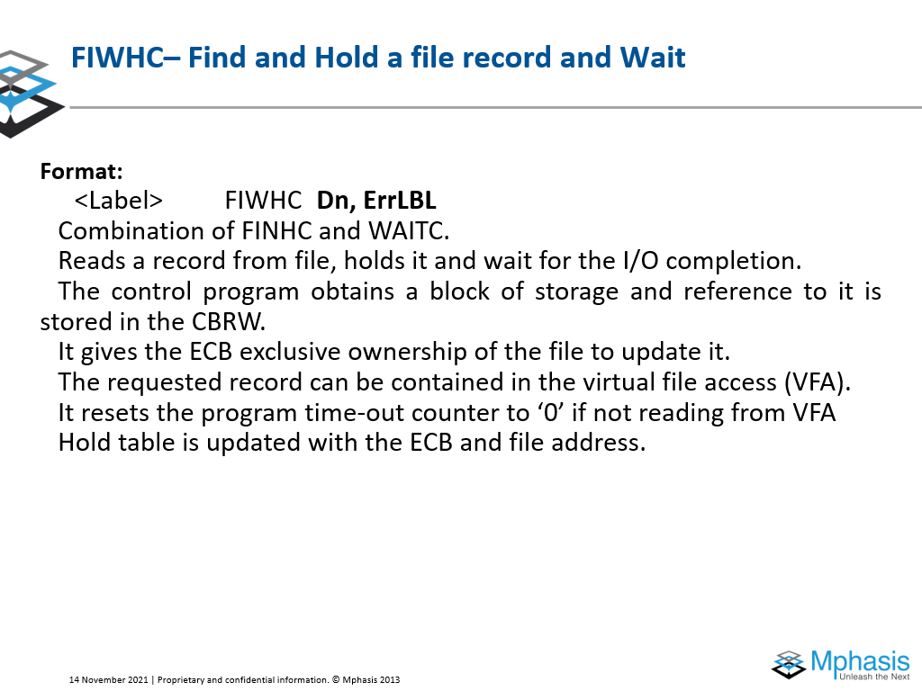
Move Zones
Eg., MVZ 0(3,R1),10(R1)
Op code – D3 02 10 00 10 0A
Eg., MVZ 2(1,R1),10(R1)
Op code – D3 00 10 02 10 0A

Slide 14
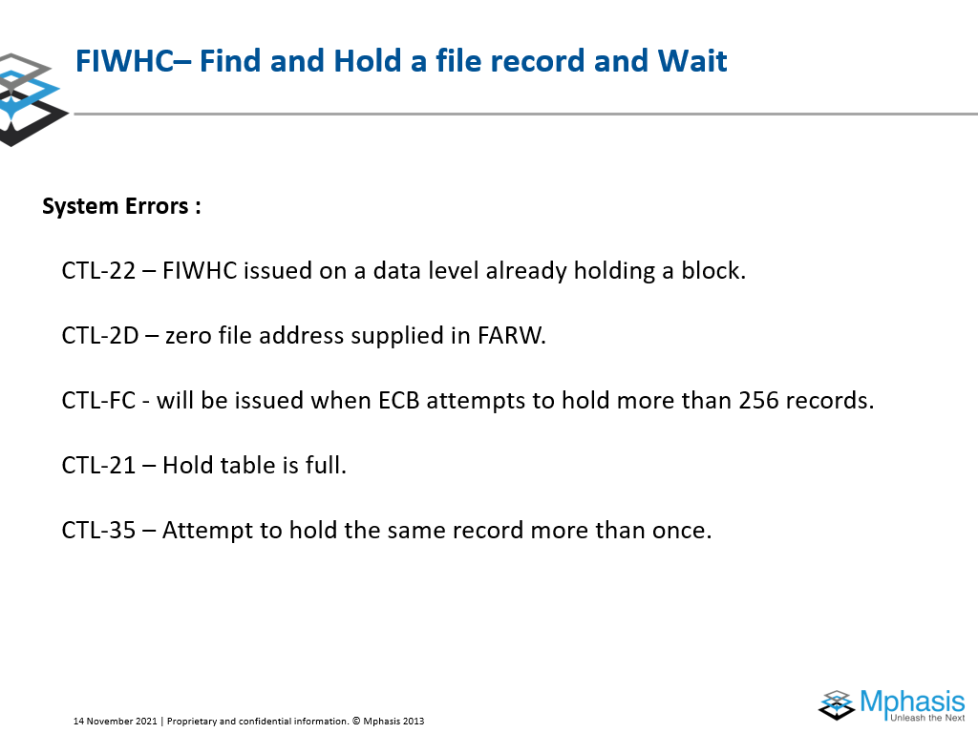
Move Zones
Eg., MVZ 0(3,R1),10(R1)
Op code – D3 02 10 00 10 0A
Eg., MVZ 2(1,R1),10(R1)
Op code – D3 00 10 02 10 0A

Slide 15
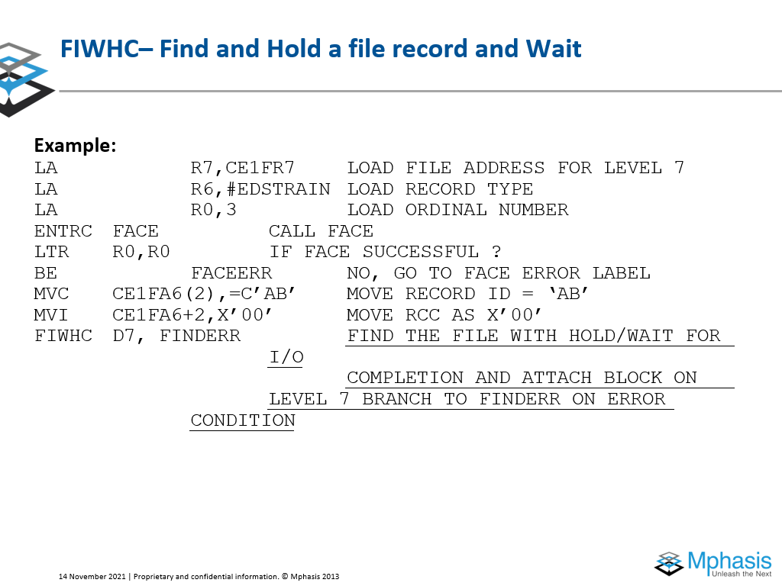
Move Zones
Eg., MVZ 0(3,R1),10(R1)
Op code – D3 02 10 00 10 0A
Eg., MVZ 2(1,R1),10(R1)
Op code – D3 00 10 02 10 0A

Slide 16
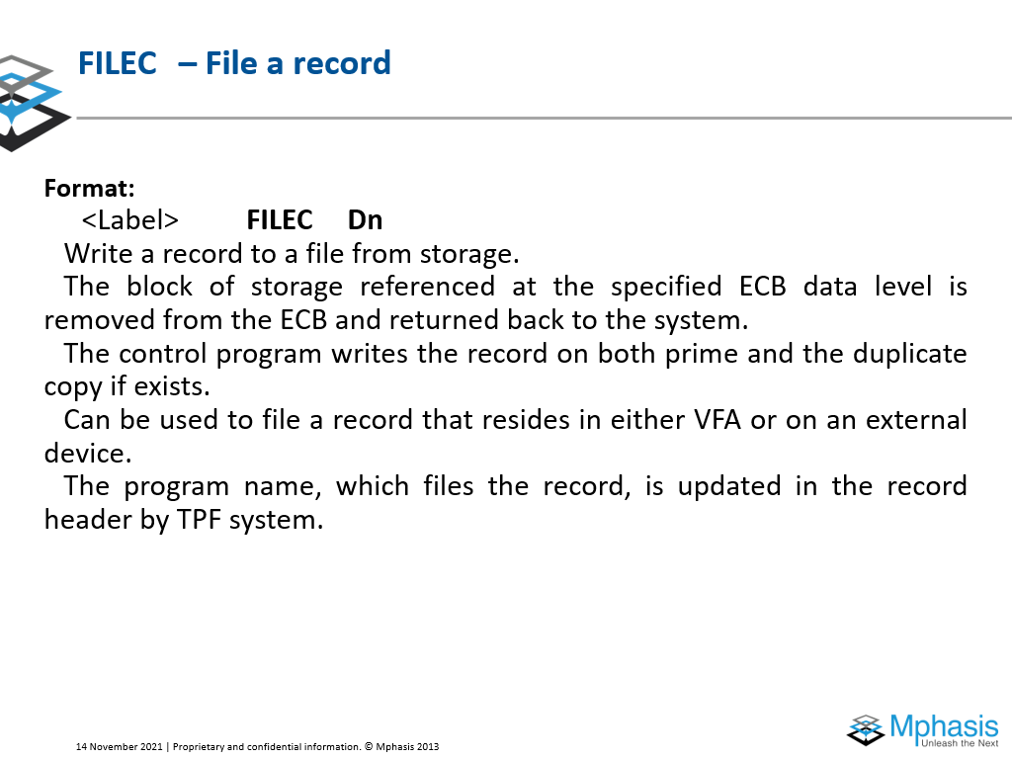
Move Zones
Eg., MVZ 0(3,R1),10(R1)
Op code – D3 02 10 00 10 0A
Eg., MVZ 2(1,R1),10(R1)
Op code – D3 00 10 02 10 0A

Slide 17
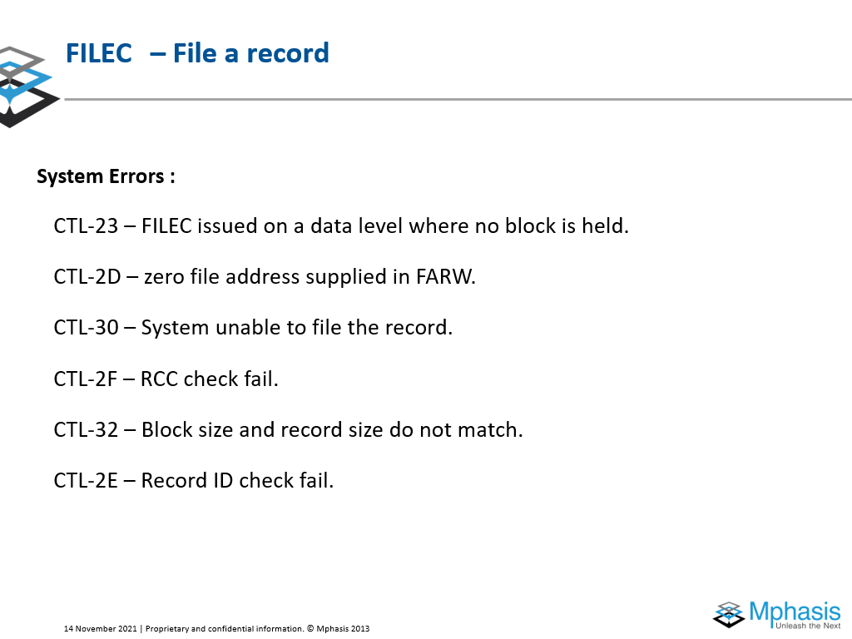
Move Zones
Eg., MVZ 0(3,R1),10(R1)
Op code – D3 02 10 00 10 0A
Eg., MVZ 2(1,R1),10(R1)
Op code – D3 00 10 02 10 0A

Slide 18
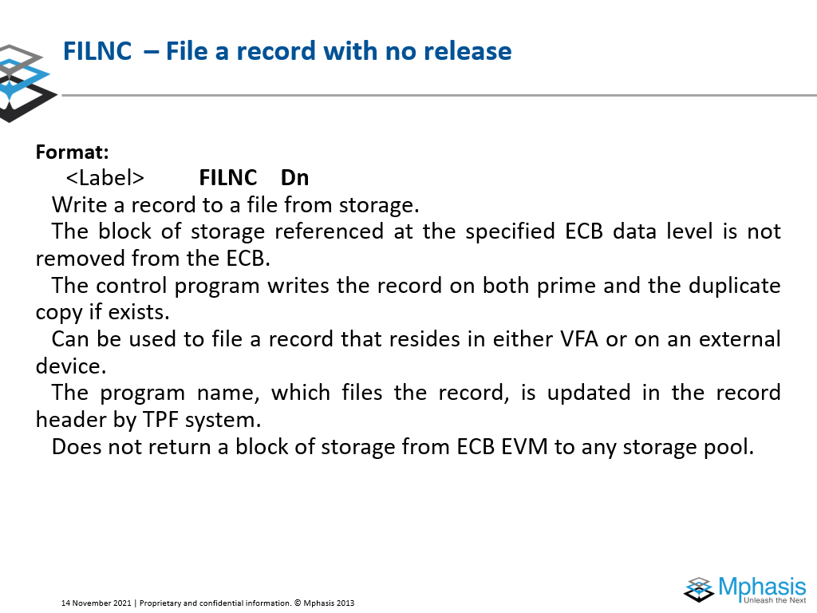
Move Zones
Eg., MVZ 0(3,R1),10(R1)
Op code – D3 02 10 00 10 0A
Eg., MVZ 2(1,R1),10(R1)
Op code – D3 00 10 02 10 0A

Slide 19
Move Zones
Eg., MVZ 0(3,R1),10(R1)
Op code – D3 02 10 00 10 0A
Eg., MVZ 2(1,R1),10(R1)
Op code – D3 00 10 02 10 0A

Slide 20
Move Zones
Eg., MVZ 0(3,R1),10(R1)
Op code – D3 02 10 00 10 0A
Eg., MVZ 2(1,R1),10(R1)
Op code – D3 00 10 02 10 0A

Slide 21
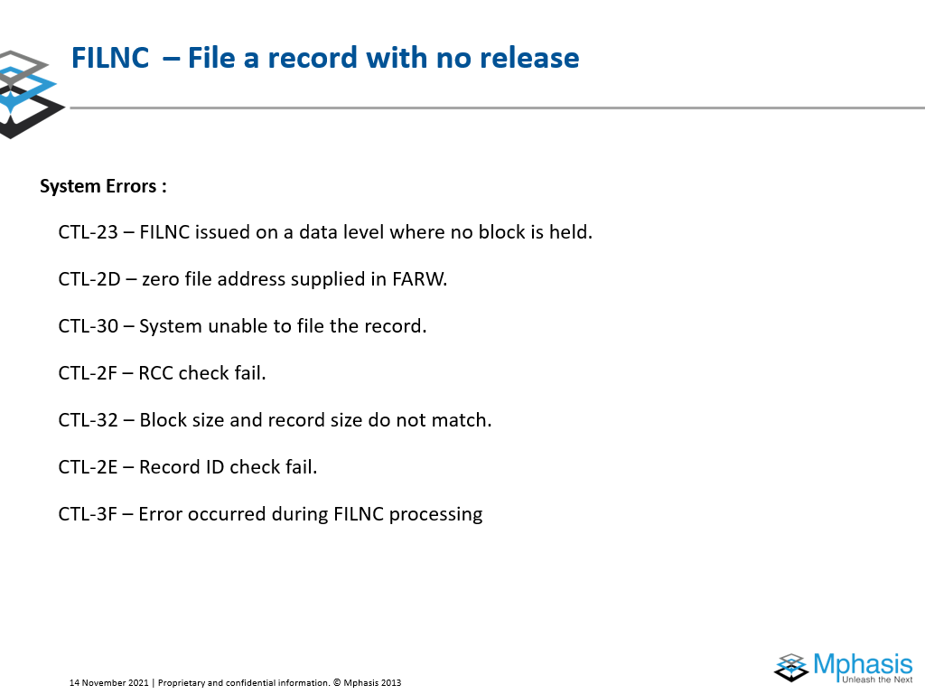
Move Zones
Eg., MVZ 0(3,R1),10(R1)
Op code – D3 02 10 00 10 0A
Eg., MVZ 2(1,R1),10(R1)
Op code – D3 00 10 02 10 0A

Slide 22
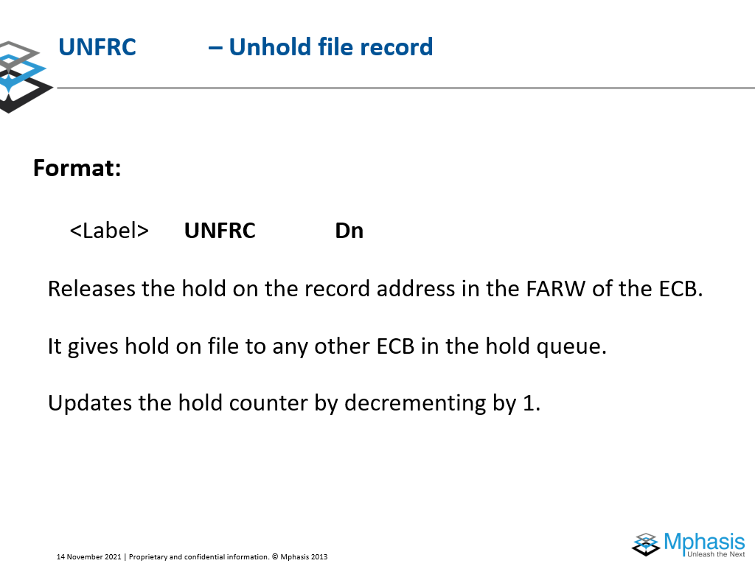
Move Zones
Eg., MVZ 0(3,R1),10(R1)
Op code – D3 02 10 00 10 0A
Eg., MVZ 2(1,R1),10(R1)
Op code – D3 00 10 02 10 0A

Slide 23
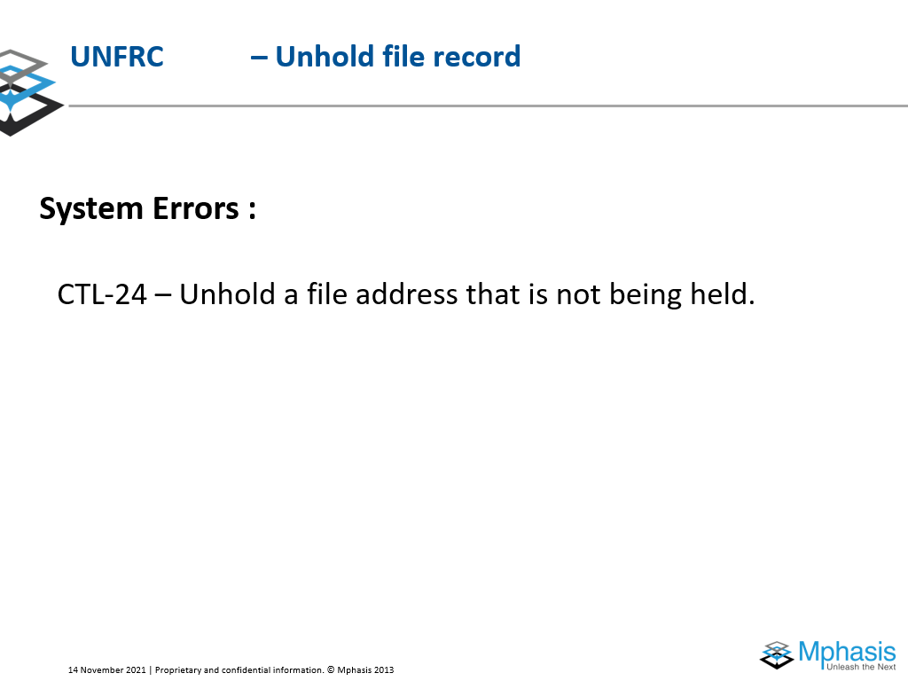
Move Zones
Eg., MVZ 0(3,R1),10(R1)
Op code – D3 02 10 00 10 0A
Eg., MVZ 2(1,R1),10(R1)
Op code – D3 00 10 02 10 0A

Slide 24
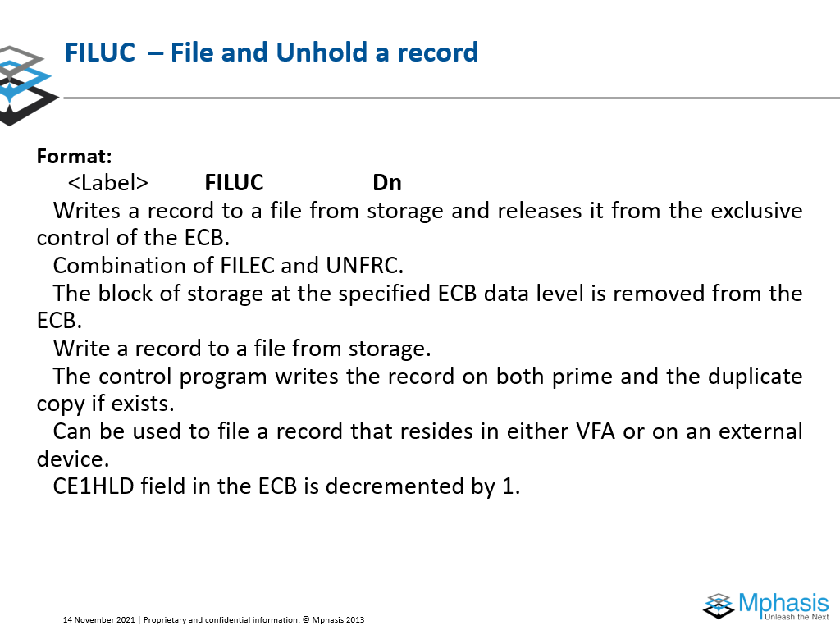
Move Zones
Eg., MVZ 0(3,R1),10(R1)
Op code – D3 02 10 00 10 0A
Eg., MVZ 2(1,R1),10(R1)
Op code – D3 00 10 02 10 0A

Slide 25
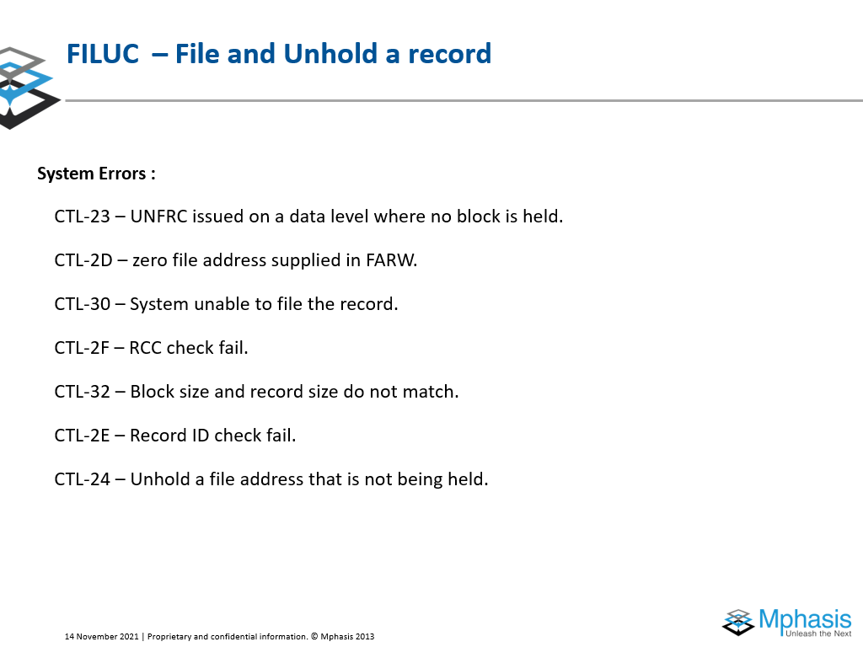
Move Zones
Eg., MVZ 0(3,R1),10(R1)
Op code – D3 02 10 00 10 0A
Eg., MVZ 2(1,R1),10(R1)
Op code – D3 00 10 02 10 0A

Slide 26
Questions!!?

